Slide 1
Extending Microsoft Teams
André Vala
Office Servers and Services MVP

Slide 2







André Vala
IT Deputy Director | Business Technology
Office Servers and Services MVP
/in/andrevala
https://andrevala.com
@atomicvee
andre.vala@gmail.com

Slide 3



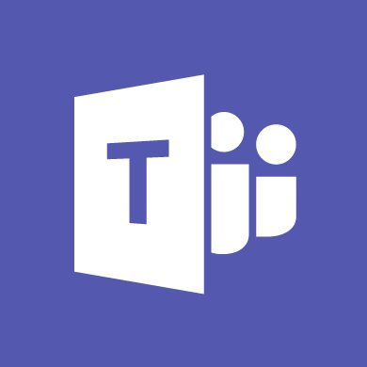




Agenda
MICROSOFT
GRAPH
APPS FOR TEAMS
PACKAGING &
DEPLOYMENT
CONCLUSION
& ROADMAP
TABS
BOTS
CONNECTORS
1
2
3
4
5
6
7
8
9
COMPOSE
EXTENSIONS
RESOURCES
& LABS
ACTIVITY FEED

Slide 4
1
Apps for Teams

Slide 5



Apps are part of teamwork
Enable teams to make decisions and take action faster
Reduce context switching on important tasks
Create opportunities for collaboration around external content
Increased Productivity

Slide 6
Why build an app for Teams?
Create enterprise-specific solutions for your end users by integrating with your existing internal services and processes
Examples
Access sales information
Time and absence reporting
Travel and expenses
Lookup benefits and HR
IT Helpdesk and Support

Slide 7





Microsoft Teams App Platform
Tabs
Surface rich content within Teams
Activity Feed
Engage users via feed notifications
Bots
Help users get tasks done in conversations
Compose Extensions
Allow users to query and share rich cards in conversations
Connectors
Post rich updates to channels
Actionable Messages
Add rich interaction to your connector cards
Microsoft Graph
Build in intelligence and connect to data that drives productivity

Slide 8
Components Scope
Component | Personal | Channel | Team
Tabs | Yes | Yes | No
Bots | Yes | No | Yes
Connectors | No | Yes | No
Activity Feed | Yes | No | No
Compose Extensions | Yes | No | Yes

Slide 9



Microsoft Teams App Package
Color icon used in app galleries, bots, flyouts and so on. Must be 96x96 pixels.
PACKAGE
ZIP file
MANIFEST.JSON
App manifest file in JSON format. Must be placed at the top level of the package.
COLOR ICON
Outline icon used in the app bar, pinned composed extensions and chiclets. Must be 20x20 pixels, white with a transparent background.
OUTLINE ICON

Slide 10
App Manifest (1/3)
{
"$schema": "https://statics.teams.microsoft.com/sdk/v1.0/manifest/MicrosoftTeams.schema.json",
"manifestVersion": "1.0",
"version": "1.0.0",
"id": "%MICROSOFT-APP-ID%",
"packageName": "com.example.myapp",
"developer": {
"name": "Publisher Name",
"websiteUrl": "https://website.com/",
"privacyUrl": "https://website.com/privacy",
"termsOfUseUrl": "https://website.com/app-tos"
},
[...]
Developer company information

Slide 11
App Manifest (2/3)
[...]
"name": {
"short": "Name of your app (max 30 chars)",
"full": "Full name of app (if greater than 30)"
},
"description": {
"short": "Short description of your app (max 80 chars)",
"full": "Full description of your app (max 4000 chars)"
},
"icons": {
"outline": "%FILENAME-20x20px%",
"color": "%FILENAME-96x96px"
},
"accentColor": "%HEX-COLOR%",
[...]
App name
App description
Relative path to application icons

Slide 12
App Manifest (3/3)
[...]
"configurableTabs": [...],
"staticTabs": [...],
"bots": [...],
"connectors": [...],
"composeExtensions": [...],
"permissions": [
"identity",
"messageTeamMembers"
],
"validDomains": [
"*.taburl.com",
"*.otherdomains.com"
]
}
App package components
(optional)
App permissions
(optional)
Valid domains from where contents can be loaded
(required only for tabs)

Slide 13
Deployment Methods
 | In-App Gallery | Office Store | Sideloading
Quality control and validation by Microsoft | Yes | Yes | No
Availability | Searchable and deployable to any Team globally | Searchable and deployable to any Team globally | Available only to the Team where it was sideloaded
Searchable in the Office Store | No | Yes | No
Searchable in the In-App Gallery | Yes | Yes | No
Required permissions | Team owner | Team owner | Team owner for sideloading, but this option must be enabled first by a tenant admin

Slide 14
2
Tabs

Slide 15
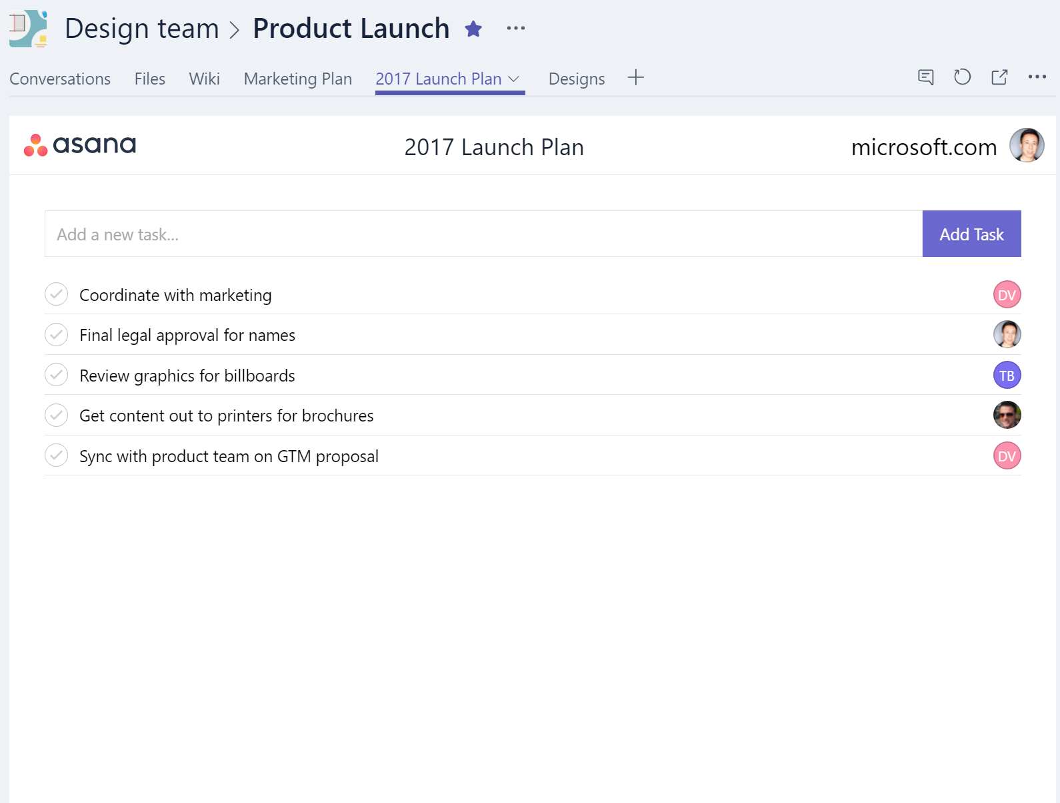
Overview
Web pages presented in Teams through an iframe
Can be used for team productivity, in channels, or for personal productivity, as an app flyout
Leverages Microsoft Teams Tab javascript library for context and interactivity
Supports deep links to native apps
Example: benefits dashboard

Slide 16
Tab Pages
Configuration Page
Page used to add or update the tab and set the content page
Content Page
The primary page displayed in the tab
Removal Page
Optional page displayed when a tab is removed

Slide 17
Tab Page Requirements
Must use HTTPS
Content must work on an iframe
Include Microsoft Teams Tab library as a script source
<script src="https://statics.teams.microsoft.com/sdk/v1.0/js/MicrosoftTeams.min.js" />
Once the page has successfully loaded, call microsoftTeams.initialize() to the display it
All domains for pages displayed in tabs must be listed in the manifest’s validDomains

Slide 18
Tab Scopes
Channel scope (configurable tab)
Tab added to a channel
Can be configured when added to the channel
Accessible by all members of the team
Personal scope (static tab)
Allows for a private interaction with the user
Accessible through the app bar
Cannot be added or removed

Slide 19
Creating a Tab
DEMO

Slide 20
Best Practices
Put information at the fingertips of users
Leverage collaborative nature of the product
Minimize context switching – easy to find what users need
Focus on content that makes sense in the solution
Minimize extra chrome – focus on what you want the user to do
Design for bite-size tasks – power users should use your full SaaS

Slide 21
Packaging
"configurableTabs": [
{
"configurationUrl": "https://taburl.com/config.html",
"canUpdateConfiguration": true,
"scopes": [ "team" ]
}
],
"staticTabs": [
{
"entityId": "idForPage",
"name": "Display name of tab",
"contentUrl": "https://teams-specific-webview.website.com",
"websiteUrl": "http://fullwebsite.website.com",
"scopes": [ "personal" ]
}
],

Slide 22
3
Bots

Slide 23
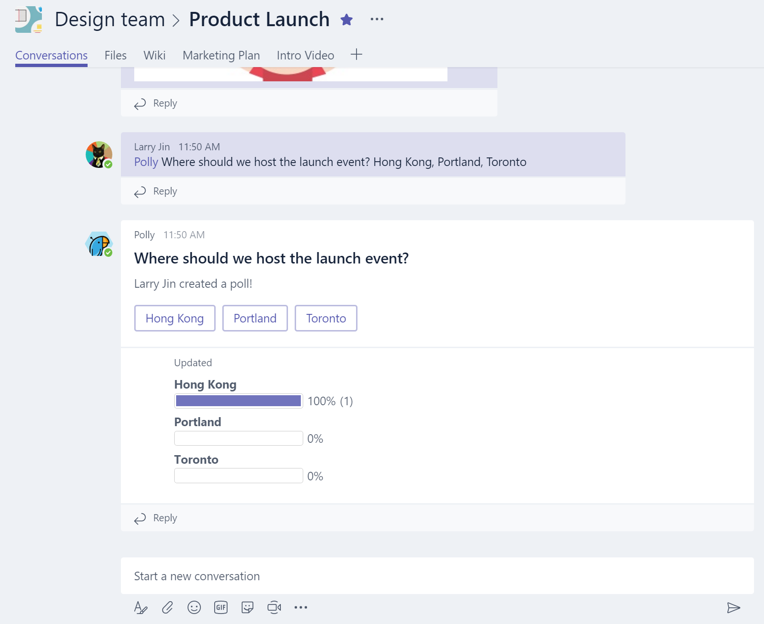
Overview
Bots make it easy for users to interact with your app in team conversations or 1:1
Built using Microsoft Bot Framework
Complete tasks via basic commands, menu or natural language
Example: time and absence entry and reporting

Slide 24
Create a Bot
Register the bot with the Microsoft Bot Framework
Build the bot using the Microsoft Teams .NET SDK, Node.js SDK or Microsoft Bot Connector API
Test it using the Bot Framework Emulator
Deploy it to a cloud service
Create an app package
Sideload it or publish the package to the store

Slide 25
Bot Builder SDK Teams Extensions
Extensions to the Bot Builder SDK that allow Teams-specific operations
Fetch a Team’s list of channels
Fetch profile info about Team members
Fetch tenant ID from an incoming message to the bot
Create a 1:1 chat with a user
Mention a specific user
Consume various events such as channel-created, team-renamed
Accept messages only from specific tenants
Write Compose Extensions

Slide 26
Message Contents
Format | User > Bot | Bot > User | Notes
Rich Text | Yes | Yes
Pictures | Yes | Yes | Max 1024x1024 and 1MB (PNG, JPG or GIF)
Cards | No | Yes | Hero, Thumbnail and Office 365 Connector cards
Emojis | No | Yes | Via UTF-16

Slide 27
Creating a Bot
DEMO

Slide 28
Best Practices
Whether used as a CLI for your SaaS, or to manage workflows, create the experience that makes the most sense for your end users
Use context to provide the appropriate functionality in channel vs 1:1 chat
Leverage the Bot Framework and Microsoft Teams SDKs to easily consume APIs
Use the input menu to keep your end users “on rails”

Slide 29
Packaging
"bots": [
{
"botId": "%MICROSOFT-APP-ID-REGISTERED-WITH-BOT-FRAMEWORK%",
"needsChannelSelector": "true",
"isNotificationOnly": "false",
"scopes": [ "team", "personal" ],
"commandLists": [
{
"scopes": ["team"],
"commands": [
{
"title": "Command 1",
"description": "Description of Command 1"
},
{
"title": "Command N",
"description": "Description of Command N"
}
]
}
]
}
],

Slide 30
4
Connectors &
Actionable Messages

Slide 31
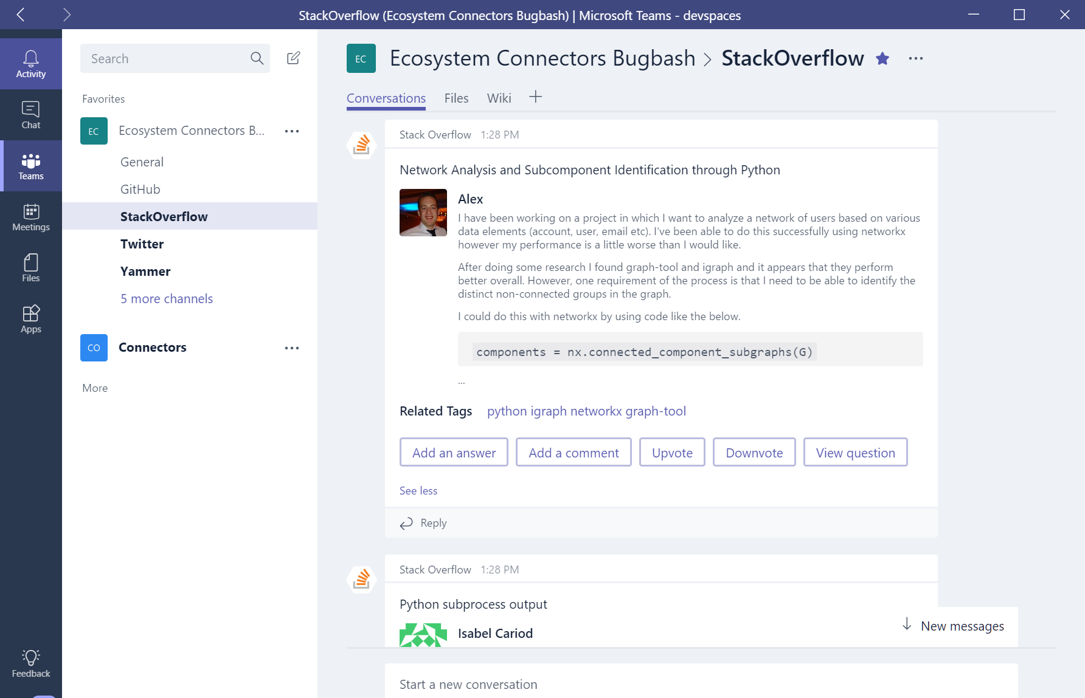
Overview
Leverages incoming webhook API
Send activities into Teams (or Groups)
Push rich interactive cards into channels for user quick actions
Supported in Outlook, Teams and Yammer
Build your own connector
Example: incident notifications

Slide 32
Create a Connector
Register the connector (https://outlook.office.com/connectors/publish)
Create a landing page for users with a Connect button
Create a callback page to store the webhook URL
Deploy it to a cloud service
Create an app package
Sideload it or publish the package to the store
Install the connector to a channel

Slide 33
Send Actionable Message
Create an actionable message card
Create a request with the card definition (JSON) as payload
POST the request to the webhook URL

Slide 34
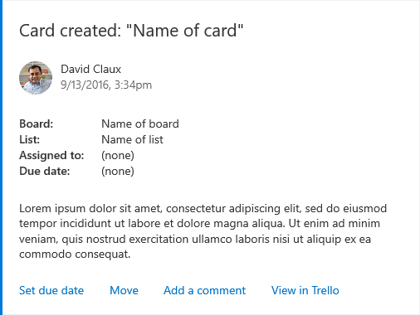
Office 365 Connector Cards
card title
section’s activityImage
section‘s activityTitle
section‘s activitySubtitle
MAX
10
section‘s facts
section
section‘s text
section‘s potentialActions
MAX
5
Card Playground
https://messagecardplayground.azurewebsites.net/

Slide 35
Using a Connector
DEMO

Slide 36
Packaging
"connectors": [
{
"connectorId": "GUID-FROM-CONNECTOR-DEV-PORTAL",
"scopes": [ "team"]
}
],

Slide 37
5
Activity Feed

Slide 38
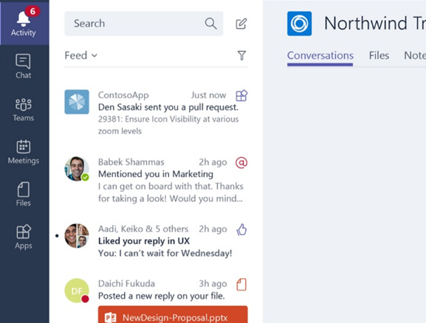
Overview
Notify users personally via the activity feed
Same API as sending bot messages
Deep links straight into tabs
Example: new approval request

Slide 39
Packaging
"bots": [
{
"botId": "%MICROSOFT-APP-ID-REGISTERED-WITH-BOT-FRAMEWORK%",
"needsChannelSelector": "true",
"isNotificationOnly": "true",
"scopes": [ "team", "personal" ],
"commandLists": [
{
"scopes": ["team"],
"commands": [
{
"title": "Command 1",
"description": "Description of Command 1"
},
{
"title": "Command N",
"description": "Description of Command N"
}
]
}
]
}
],

Slide 40
6
Compose Extensions

Slide 41
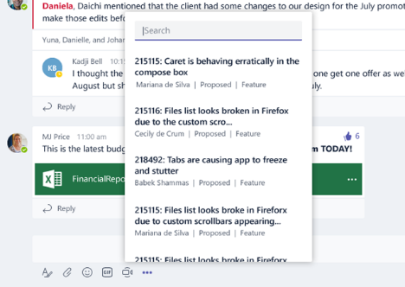
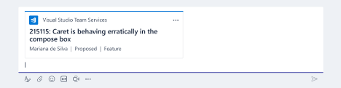
Overview
Personalize Teams Compose box with your App & Services content
Users can query and insert your app content into conversations
Example: lookup and share a company resource

Slide 42
Best Practices
Share content that makes sense in conversations
Take advantage of the rich card types
Optimize search results to keep it snappy and responsive
Leverage Teams SDKs to easily add your core bot offering

Slide 43
Packaging (manifest.json)
"composeExtensions": [
{
"botId": "%MICROSOFT-APP-ID-REGISTERED-WITH-BOT-FRAMEWORK%",
"scopes": ["team", "personal"],
"commands": [
{
"id": "exampleCmd",
"title": "Example Command",
"description": "Command Description e.g. Search on the web",
"initialRun": "true",
"parameters": [
{
"name": "keyword",
"title": "Search keywords",
"description": "Enter the keywords to search for"
}
]
}
]
}
],

Slide 44
7
Microsoft Graph

Slide 45
Overview
Integrate with the Microsoft Graph in your Teams app
Leverage existing Graph APIs like emails, documents, and calendar
Teams-specific APIs available in Beta with more coming soon
Create/Get/Update Team
Create/Get/List Channels
Create Chat Thread
Get Chat Messages

Slide 46
8
Conclusions & Roadmap

Slide 47
Putting it all together
Microsoft Teams
Your App
Personal
Activity Feed
NOTIFICATION
Microsoft Bot Framework
Bot
Chat 1:1
CHAT 1:1
Connector
COMPOSE EXTENSION
Tab
Tab
STATIC TAB
Page
Teams
Page
TEAM CHAT
COMPOSE EXTENSION
Team
Channel
Channel
Conversation
Conversation
ACTIONABLE MESSAGE
Tab
Tab
CONFIGURABLE TAB

Slide 48
Roadmap
Now available
Command bar
Lobby support
Transfer to PSTN call
Anonymous join call
Safe call transfer
Later
Team templates
Out of office support
Organizational auto-attendant
Forward group
Do not disturb breakthrough
Call queues
Whiteboard and meeting notes
PowerPoint load and share
Escalate 1:1 chat/call to multi-party
Large meeting support (250 participants)
Cloud recording
Broadcast meetings
Calling support between Teams and Skype consumer
Group call pickup
Location based routing
Soon
Federated chat between Teams and Skype for Business
Enable call quality analytics
Message retention policies
Import contacts from Skype for Business
Give and take control in sharing
Share/mute chat
Unified presence
Support for contact groups

Slide 49
9
Resources & Labs

Slide 50


Resources
9 RESOURCES & LABS
Code Samples
https://developer.microsoft.com/en-us/microsoft-teams/gallery/?filterBy=Samples,Microsoft%20Teams
Official Documentation
http://aka.ms/TeamsDocs
YouTube Teams Channel
http://aka.ms/TeamsVideos

Slide 51
Lab 1
9 RESOURCES & LABS
60 min
Create a tab for Microsoft Teams
https://github.com/OfficeDev/TrainingContent/blob/master/Teams/01%20Tabs/Lab.md
In this exercise, you will create a web site to host the configuration and content pages for the Microsoft Teams tab and publish it to Azure.
Prerequisites
To complete the step-by-step instructions in this lab, you will need:
Office 365 Tenant and Microsoft Azure subscription
Microsoft Teams must be turned on in the tenant
Microsoft Teams must be installed
Visual Studio 2017 with ASP.NET and web application components

Slide 52
Lab 2
9 RESOURCES & LABS
30 min
Create Office 365 Connectors for Microsoft Teams
https://github.com/OfficeDev/TrainingContent/blob/master/Teams/02%20Connectors/Lab.md
Office 365 Connectors are a great way to get useful information and content into Microsoft Teams. Any user can connect their team to services like Trello, GitHub, Bing News, Twitter, etc., and get notified of the team's activity in that service. From tracking a team's progress in Trello, to following important hashtags in Twitter, Office 365 Connectors make it easier for your team to stay in sync and get more done. Office 365 Connectors also provide a way for developers to integrate with Microsoft Teams by building custom incoming webhooks Connectors to generate rich cards within channels.
Prerequisites
To complete the step-by-step instructions in this lab, you will need:
Office 365 Tenant and Microsoft Azure subscription
Microsoft Teams must be turned on in the tenant
Microsoft Teams must be installed
Curl must be installed
Visual Studio 2017 with ASP.NET and web application components

Slide 53
Lab 3
9 RESOURCES & LABS
30 min
Create a Bot in Microsoft Teams
https://github.com/OfficeDev/TrainingContent/blob/master/Teams/03%20Bots/Lab.md
Microsoft Teams is a chat-based conversation tool that contains everything your team needs to keep in touch. You can extend Teams by building Bots and Connectors, as well as extending the user interface with custom Tabs. In this training module, we’ll build a Bot that integrates with Teams.
Prerequisites
To complete the step-by-step instructions in this lab, you will need:
Office 365 Tenant and Microsoft Azure subscription
Visual Studio 2017 and bot templates installed
Microsoft Teams must be turned on in the tenant
Microsoft Teams must be installed

Slide 54
Additional Labs
9 RESOURCES & LABS
8 hours
Creating Microsoft Teams Apps (by Paul Schaeflein)
https://github.com/pschaeflein/hol-microsoft-teams
This hands-on lab is composed of several modules which will help you learn how to develop apps for Teams, leveraging its many extensibility points. It covers the following topics:
Module 1: Create and Test a Basic Teams App using Yeoman
Module 2: Call Microsoft Graph inside a Tab
Module 3: Create a basic Teams bot
Module 4: Add Microsoft Teams functionality to a bot
Module 5: Creating Compose Extensions
Module 6: Connectors & webhooks
Prerequisites
To complete this lab, you will need to prepare your environment by following the instructions here:
https://github.com/pschaeflein/hol-microsoft-teams/blob/master/Prerequisites.md

Slide 55
Engage

Slide 56

Thank You!

